Slide 1
Unit 6

Slide 2
Without code
https://monkeylearn.com/blog/no-code-machine-learning/
https://app.monkeylearn.com/main/module-create/classifier/wizard/data-source/
Power BI
https://www.youtube.com/watch?v=3u7MQz1EyPY
Tableau
https://www.youtube.com/watch?v=aHaOIvR00So
https://www.youtube.com/watch?v=UWT14hhjsL0
https://www.youtube.com/watch?v=_XbzJWlfNPU -Time series data
SPSS Data Analysis Tools
https://www.youtube.com/watch?v=sFH6tgylE2k- Timeseries data

Slide 3
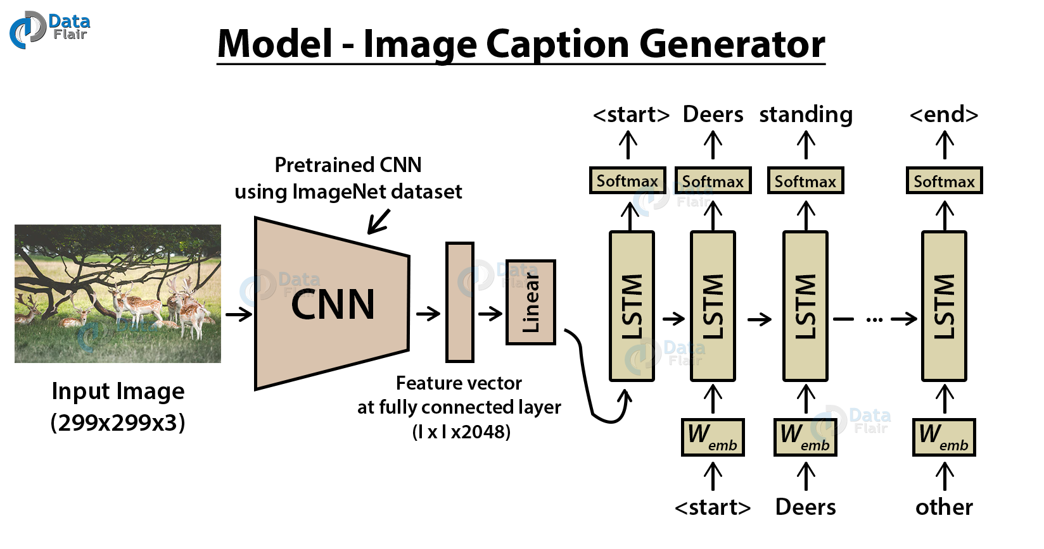

Slide 4
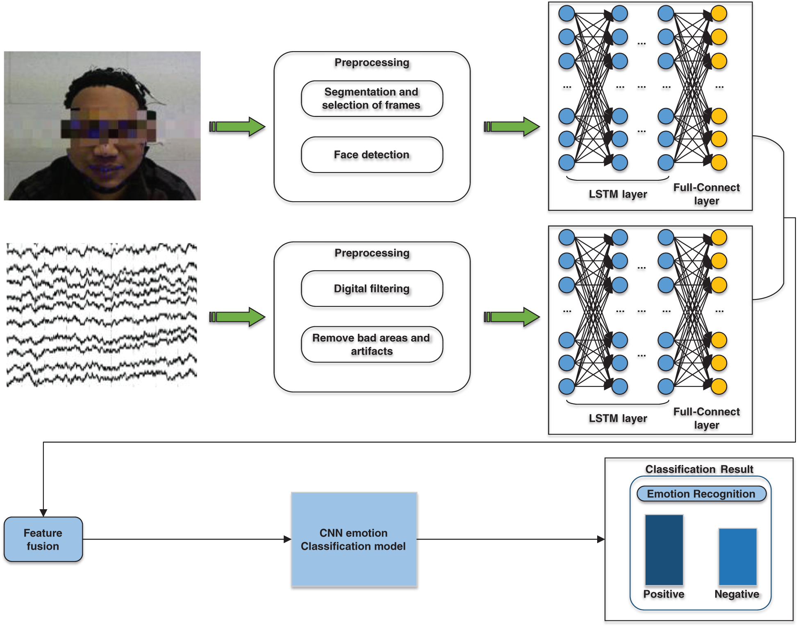
Emotion recognition – CNN and LSTM

Slide 5
Emotion recognition – CNN and LSTM
CNN-Face Feature-Image - Sad/Happy/Neutral
Person image –RCNN –Image classification –Sad/Happy/Neutral
Speech data, Face Image

Slide 6
Tweet Classification
Disaster Tweet Classification
https://medium.com/analytics-vidhya/introduction-to-nlp-with-disaster-tweets-3b672a75748c
Classification of Covid-19 Tweets Using Deep Learning Techniques
https://link.springer.com/chapter/10.1007/978-981-16-1395-1_10

Slide 7
Examples
User emotion detection for news article impact analysis
Input: News article, face images of the user while reading news, history of articles read by user Output: Prediction of emotions of a user for different articles
Question answering system for automated customer relationship management
Input: Questions from customers spoken/written in regional languages Output: Answers (spoken/written) from the automated system in regional language

Slide 8
